Slide 1

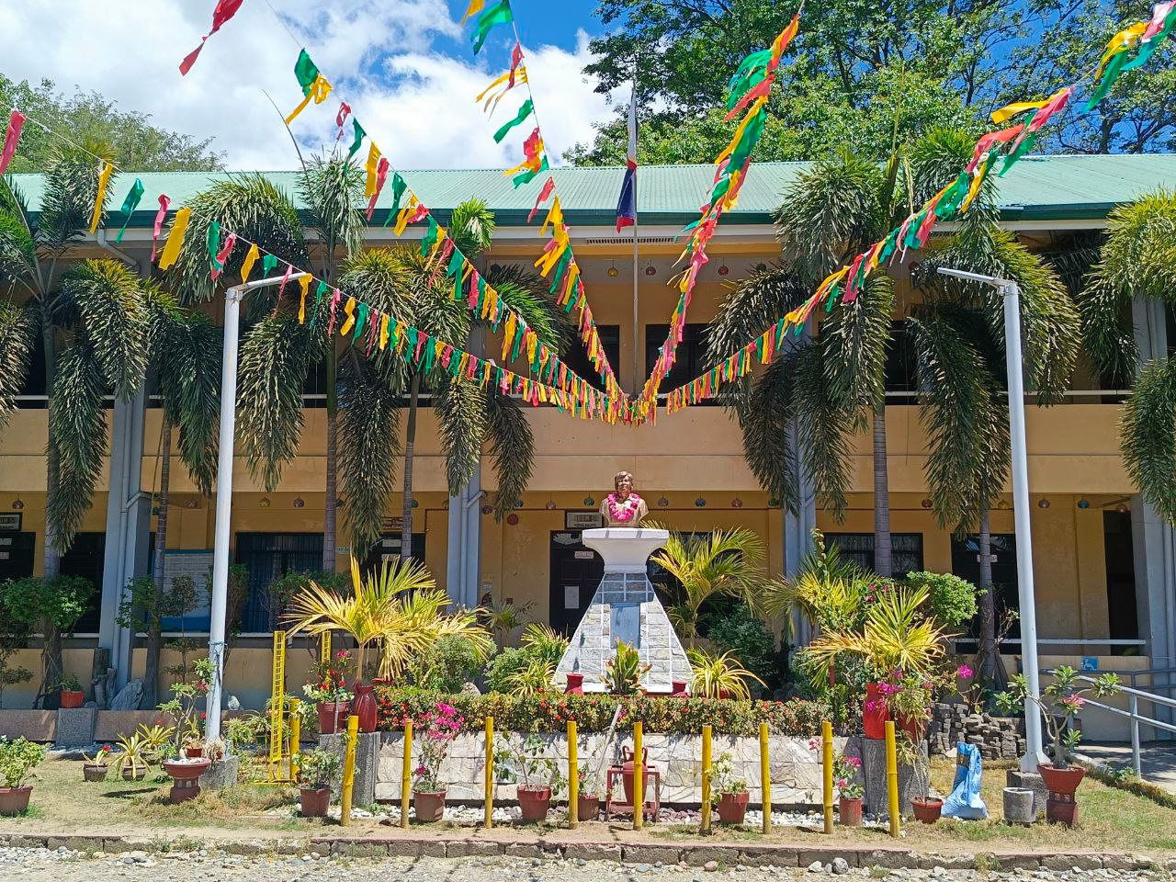



Learning Management System of NUEST - MGT BSIT Program
SAMPLE MODULE

Slide 2
Page 1
SAMPLE MODULE

Slide 3
Page 2
SAMPLE MODULE

Slide 4
Page 3
SAMPLE MODULE

Slide 5
Page 4
SAMPLE MODULE

Slide 6
Page 5
SAMPLE MODULE

